Slide 1
RETAIL MANAGEMENT DATABASE DESIGN

Slide 2
Objective
To describe
The process for Database creation.
The attributes and entities that have been tracked in the database.
The query writing to fetch data, performance tuning using indexes, managing database integrity and data generation.

Slide 3
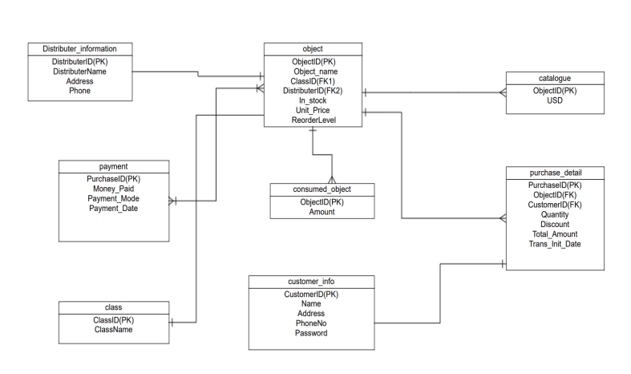
Entity-Relationship Diagram

Slide 4
Business Rules
One object can have a single object_ID and multiple purchase_ID.
Customer can order multiple purchase_ID.
One product can have more than a single customer.
One distributer can have multiple objects under him and the object can also have multiple distributers.

Slide 5
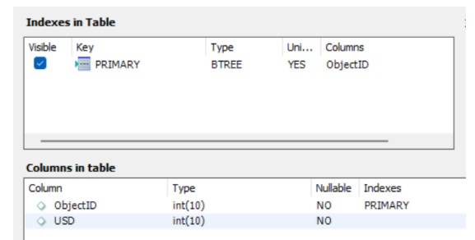
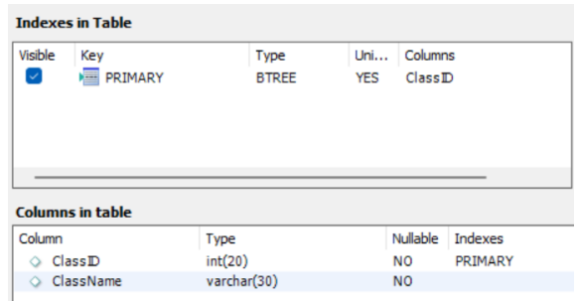
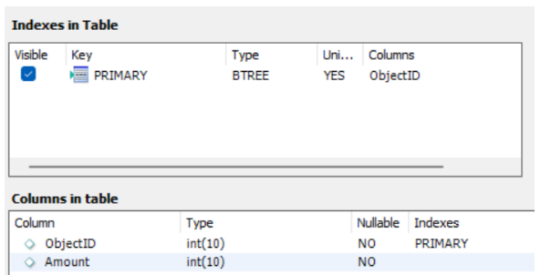
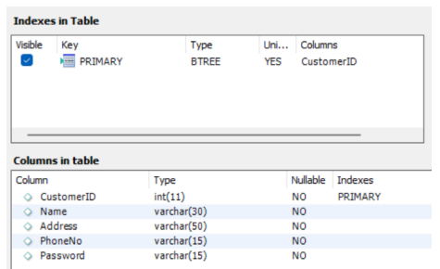
Table Views
Catalogue Table Class Table
Consumed Object table Customer info table

Slide 6
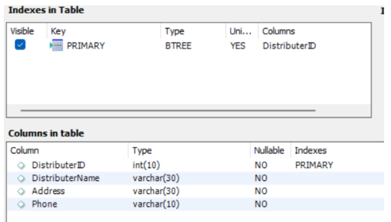
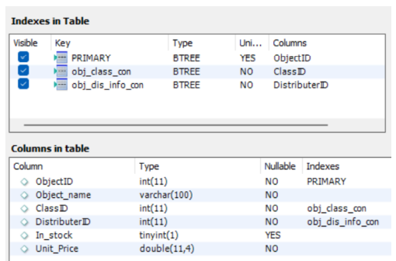
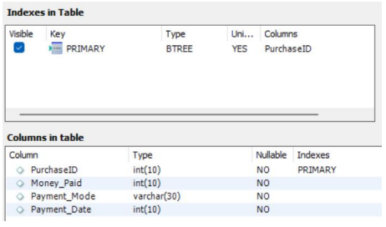
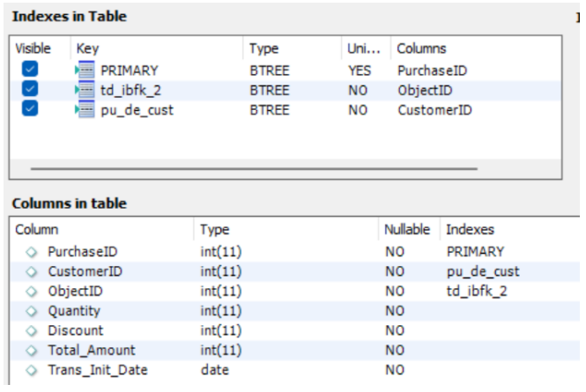
Distributer information table Object table
Payment table Purchase detail table

Slide 7
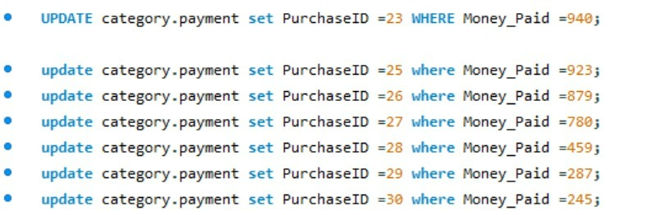
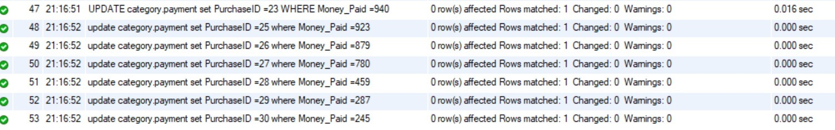
We updated payment table for different purchase IDs

Slide 8
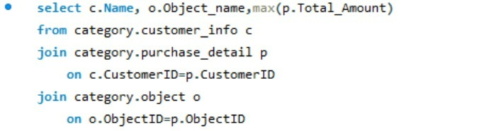

Finding the customer who spent the highest amount, total amount spent by the customer and the object bought

Slide 9
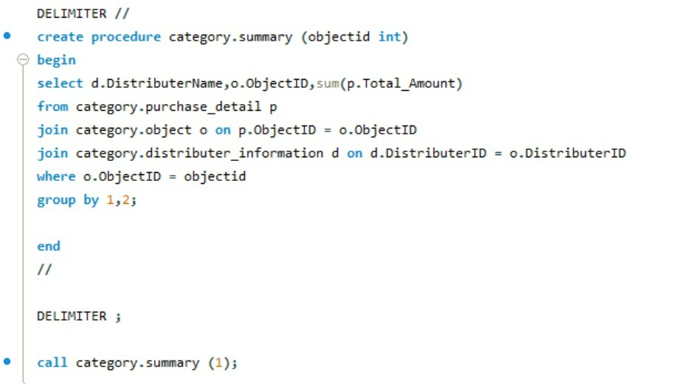
We created a procedure to get the total amount for different distributers based on ObjectID

Slide 10
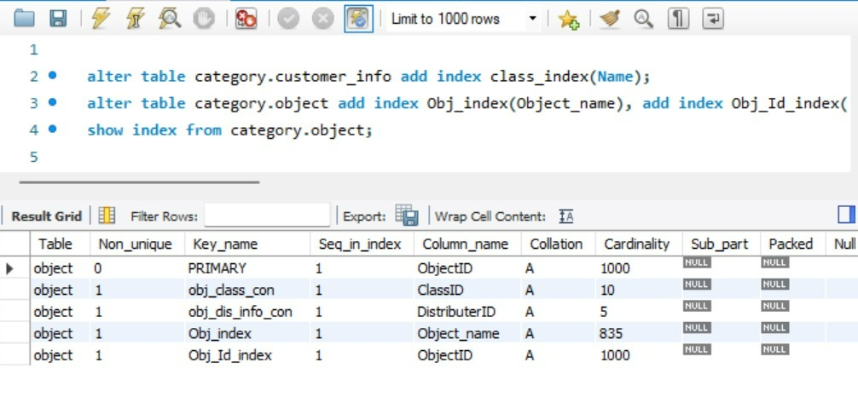
PERFORMANCE TUNING Adding index to the table customer_info with the column Name Adding index to the table object with the column Object_name and Object_id

Slide 11
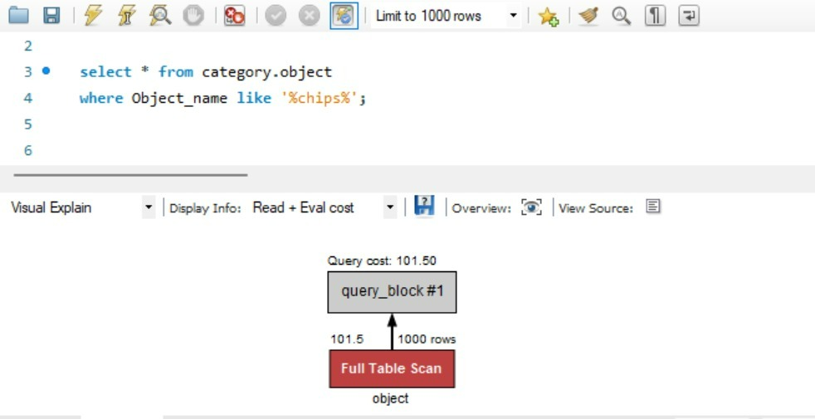
Cost of the query without indexing which is 101.5

Slide 12
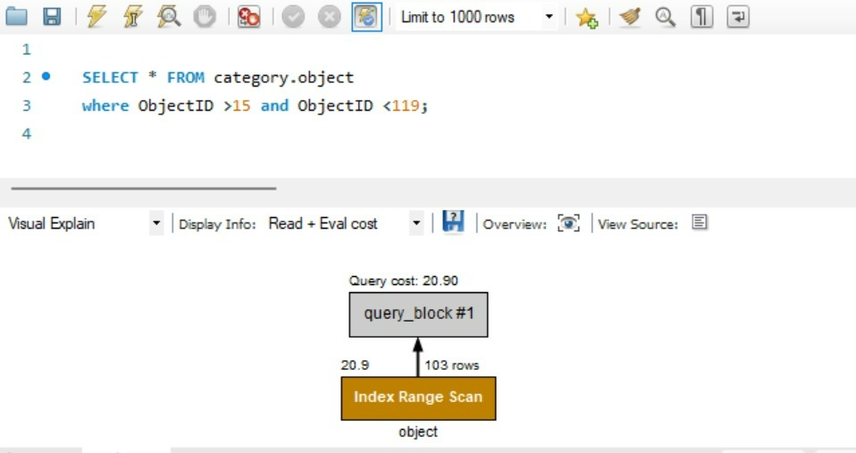
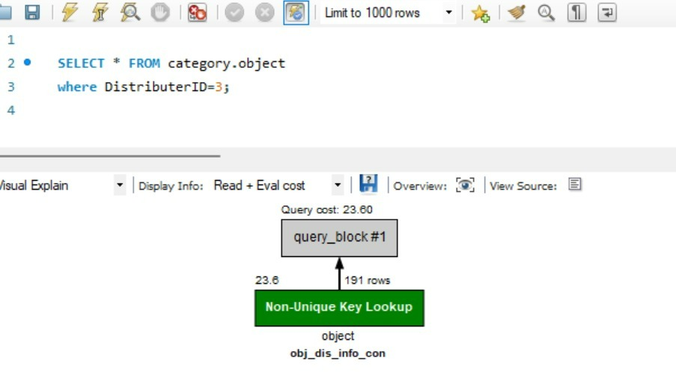
We can see a considerable decrease in cost of the queries after indexing

